Slide 1
User Interface Design Patterns
Lecturer: Ngo Huy Bien
Software Engineering Department
Faculty of Information Technology
VNUHCM - University of Science
Ho Chi Minh City, Vietnam
nhbien@fit.hcmus.edu.vn

Slide 2

Objectives
To design user interfaces using patterns.

Slide 3

Contents

Slide 4

References

Slide 5
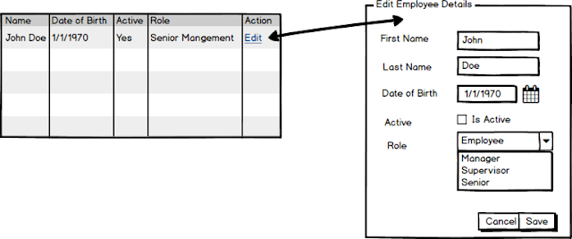
Employee Management Example

Slide 6
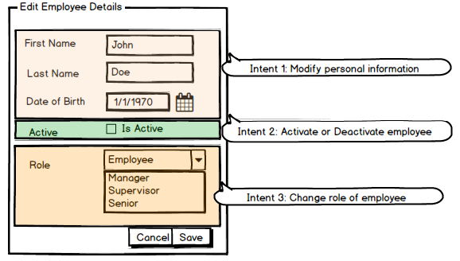
CRUD Based UI
This "Edit Employee Details" has 3 intents as shown below:
This type of UI is called as CRUD (create, read, updated, delete) based UI because a single screen is used for all the user intents (like activate, change role, etc) and it just act as an interface for database operations.

Slide 7
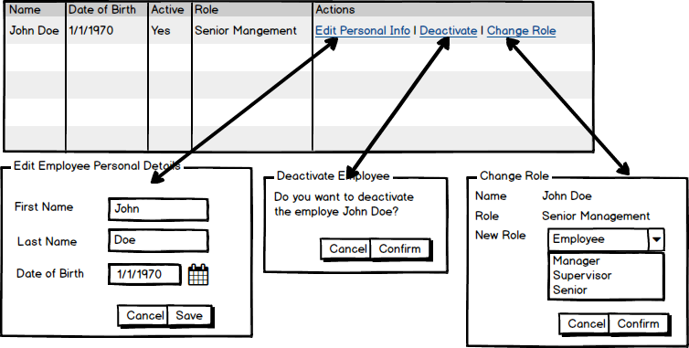
Task Based UI
Task Based UI is based on users intent.
The corresponding Task Based UI will have 3 different UIs for the three different intents as shown below:

Slide 8
Sample Code
public class Todo
{
public Date getDateAssigned();
public void setDateAssigned(Date);
public string getAssignedTo();
public void setAssignedTo(string);
}
CRUD Based UI
public class Todo
{
public Date getDateAssigned();
public string getAssignedTo();
public void AssignTo(string userId);
}
Task Based UI

Slide 9

Thank You & See You Again

